Slide 1


European Education and Culture
Executive Agency
EURYDICE
REPORT
Addressing underachievement
in literacy, mathematics
and science
Policy changes in Europaean
school educ ation since 2020
School
education

Slide 2

Addressing underachievement in literacy, mathematics and science.
Policy changes in European school education since 2020
Every student in Europe should have the chance to master the basic skills that open doors to learning, new opportunities, and future. Literacy, mathematics, science, digital skills and citizenship are more than school subjects – they are the foundations of lifelong learning, employability, civic participation and personal growth. However, recent international assessments reveal an increasing number of students in Europe who complete compulsory education without reaching the expected levels of basic skills. This is a serious concern for equity, educational quality, and Europe’s capacity to meet future challenges.
In response to this, the European Commission has placed basic skills at the heart of its broader education and skills agenda. This Eurydice report analyses how 37 education systems across Europe are tackling underachievement in literacy, mathematics and science at primary and lower secondary levels. It focuses on policies adopted or implemented since the 2020/2021 school year.
Across seven chapters, the report shows how countries are shaping an ecosystem of policy measures: adopting strategic frameworks, revising curricula, reorganising instruction, improving assessment, reinforcing learning support, strengthening support for teachers and inclusive practices, and engaging parents more closely in their children’s learning. At the centre of this ecosystem are teachers, supported through professional development, inclusive pedagogical resources and the recruitment of specialised staff.
Taken together, these policy measures demonstrate a shared ambition across Europe: to ensure that no learner is left behind, and that every young person can build the strong foundations they need to thrive in school and in life.
The Eurydice Network’s task is to understand and explain how Europe’s different education systems are organised and how they work. The network provides descriptions of national education systems, comparative studies devoted to specific topics, indicators and statistics. All Eurydice publications are available free of charge on the Eurydice website or in print upon request. Through its work, Eurydice aims to promote understanding, cooperation, trust and mobility at European and international levels. The network consists of national units located in European countries and is coordinated by the European Education and Culture Executive Agency (EACEA).
For more information about Eurydice, see:
https://eacea.ec.europa.eu/national-policies/eurydice/
^{Print}
^{ISBN 978-92-9488-939-3}
^{doi:10.2797/992314}
^{EC-01-25-073-EN-C}
^{PDF}
^{ISBN 978-92-9488-938-6}
^{doi:10.2797/1883015}
^{EC-01-25-073-EN-N}

Slide 3





































Slide 4

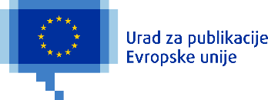



















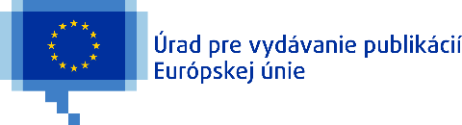



Slide 5



























Slide 6
























